Slide 1
PROJECT TITLE
CHRONIC KIDNEY DISEASE ANALYSIS
USING ML
DEVELOPED BY:
DASARI. GAYATHRI
SOMAREDDY. VIDYAVALI
KUCHANA. SAI KRISHNA
BOMMARABOINA.AKHILA SHREE

Slide 2
PROJECT DESCRIPTION:
The definition and classification for chronic kidney disease was proposed by the National Kidney Foundation Kidney Disease Outcomes Quality Initiative (NKF-KDOQI) in 2002 and endorsed by the Kidney Disease: Improving Global Outcomes (KDIGO) in 2004. This framework promoted increased attention to chronic kidney disease in clinical practice, research and public health, but has also generated debate. It was the position of KDIGO and KDOQI that the definition and classification should reflect patient prognosis and that an analysis of outcomes would answer key questions underlying the debate.

Slide 3
INTRODUTION:
Chronic kidney disease includes conditions that damage your kidneys and decrease their ability to keep you healthy by doing the jobs listed.
If kidney disease gets worse, wastes can build to high levels in your blood and make you feel sick.
You may develop complications like high blood pressure, anemia (low blood count), weak bones, poor nutritional health and nerve damage.
Also, kidney disease increases your risk of having heart and blood vessel disease.
These problems may happen slowly over a long period of time. Chronic kidney disease may be caused by diabetes, high blood pressure and other disorders.
When kidney disease progresses, it may eventually lead to kidney failure, which requires dialysis or a kidney transplant to maintain life.

Slide 4
PROPOSED SOLUTION:
The main objective of this research is to use classification algorithms to identify the liver patients from healthy individuals.
This project also aims to compare the classification algorithms based on their performance factors.
To serve the medicinal community for the diagnosis of chronic kidney disease among patients..

Slide 5
ALGORITHMS PREFFERED:
The following algorithms are trained for this purpose, to choose the best performing classifier.
Logistic Regression
KNN
NB
Decision Tree
SVM
Random Forest

Slide 6
HARDWARE/SOFTWARE DESIGNING:
The steps followed in developing the model:
Data Collection: The dataset was downloaded from the UCI ML Repository.
Data Analysis: Evaluating cleanliness of the dataset by looking for any irrelevant data and handling missing data.
Search for any trends, relations and correlations.
Developing a model where the patient can be identified to be having chronic kidney disease or not

Slide 7
EXPERIMENTAL INVESTIGATIONS:
Importing the Libraries:
Pandas,Numpy,Matplotlib libraries are imported .
Numpy is the numerical python library used for doing the mathematical calculation.
Matplotlib is visualization library.
Pandas is used for data manipulation.

Slide 8
DATA VISUALIZATION:
In this data visualization module we deal with the graphical representation of the data.
For this we have to import matplotlib library.

Slide 9
Handling Missing By Mean and Mode:
Since there are lot of unfilled columns and rows in the datset we nee to handle the missing values using the mode ,if it is categorical column else by using mean.

Slide 10
Building a Model:
Since the outcome is binary and we have a reasonable number of examples at our disposal compared to number of features, this approach seems suitable.
Since for this data, it already knows the output beforehand, it continuously adjusts the weights such that when these weights summed up with their features are introduced in the logistic function, the results are as near as possible to the actual ones.
Once presented with a test value, it again inserts the value into our logistic function and returns the output as a number between 0 and 2, which represents the probability of that test value being in a particular class.

Slide 11
Train and Testing Data:
In machine learning we have to train and test the given data.
Out of 100% of the data 80% of the data undergoes training and 20% of the data undergoes testing.

Slide 12
ACCURACY:
The following algorithms are trained for this purpose, to choose the best performing classifier.
Logistic Regression:
The results of each of the classification algorithm is summarized in the table shown below.
Model | Accuracy
Logistic Regression | 0.925

Slide 13
ADVANTAGES AND DISADVANTAGES:
The benefits of this model are:
Easy interface
Straight forward results
Accurate performance calculations
Disadvantages:
As our dataset is small, it’s training dataset is similar to test dataset. So it is difficult for the model to predict accurately for larger dataset.

Slide 14
APPLICATIONS:
This project makes it easier to predict whether the patient has chronic kidney disease or not.
Future Scope:
Database should be expanded on which the system will be tested much better. Also, the model requires further improvement mostly regarding feature selection of the chronic kidney disease into multiple components.

Slide 15
Conclusion:
In this project, we have proposed methods for diagnosing chronic kidney disease in patients using machine learning techniques.
The two machine learning techniques that were used include Logistic Regression and KNN.
The system was implemented using all the models and their performance was evaluated.
Performance evaluation was based on certain performance metrics. Logistic Regression was the model that resulted in the highest accuracy with an accuracy of 92%.
A GUI, which can be used as a medical tool by hospitals and medical staff was implemented using Logistic Regression.

Slide 16
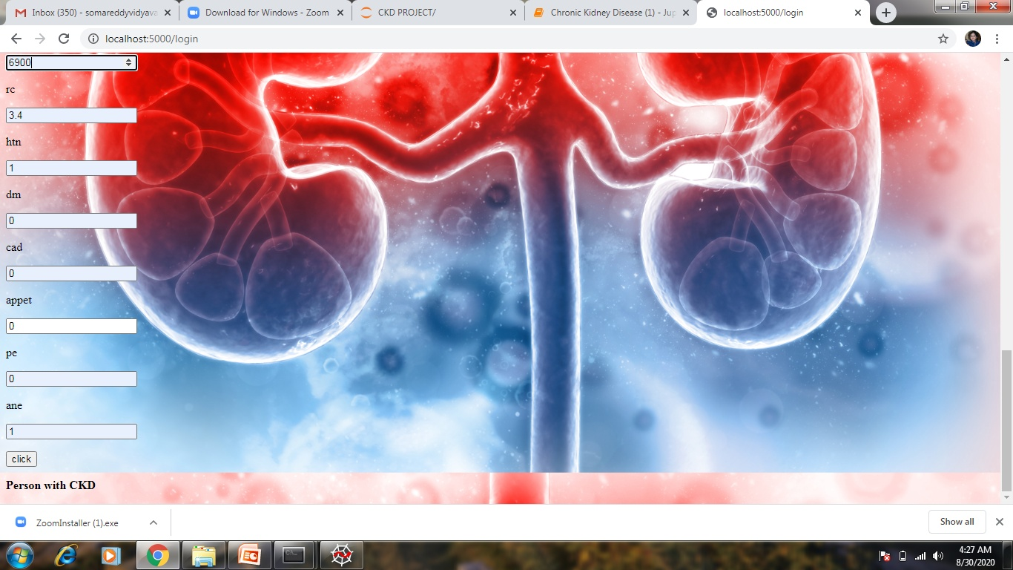
PREDICTION

